Slide 1
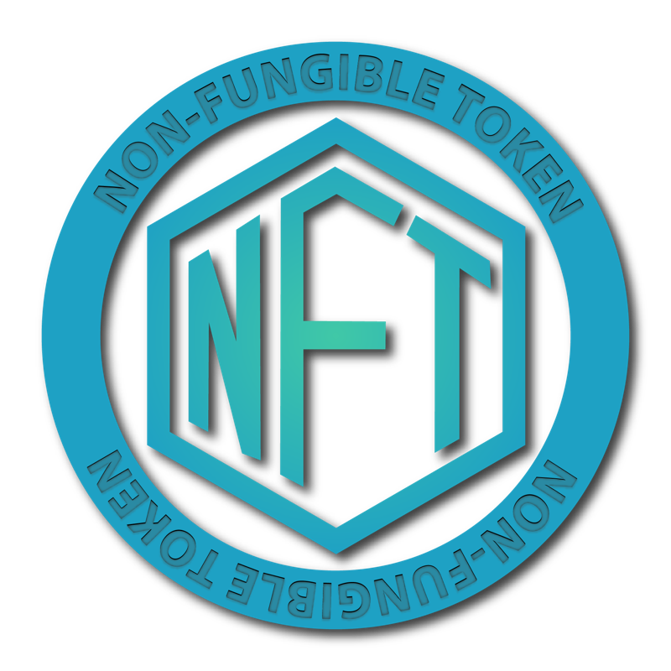
SUBMITED BY:-
JAYANT MARWAHA(01550404421)
MRINAL NARANG(03650404421)
RITESH SANDILYA(03850404421)

Slide 2
INTRODUCTION
Non-Fungible Tokens (NFTs) is entirely a novel concept in the cryptocurrency and blockchain field, and this concept is soaring every day to reach greater heights. In the real world, there are creators who keep their masterpieces inside a safety locker and fear that the ownership of their work will be snatched someday. This is the point where NFTs make their entry. It proves your ownership worldwide, and no fraudulent activities can be involved. This attracted a lot of investors and crypto lovers to kick-start their own NFT marketplaces. To enhance the visibility of this marketplace, certain NFT marketing strategies have to be carried out.

Slide 3

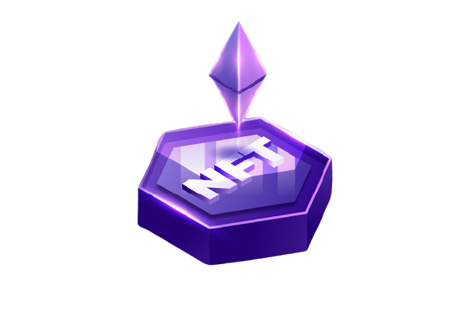
What is An NFT?
NFTs are tokens that are greatly different from regular cryptocurrencies. They hold unique data in each NFTs, making it non-interchangeable.
Say, one BTC is equivalent to another BTC. But the same is not the case in NFTs. The value in the tokens could not be replaced, replicated or even stolen.
Example:
arts, intellectual properties, virtual properties, financial instruments etc

Slide 4
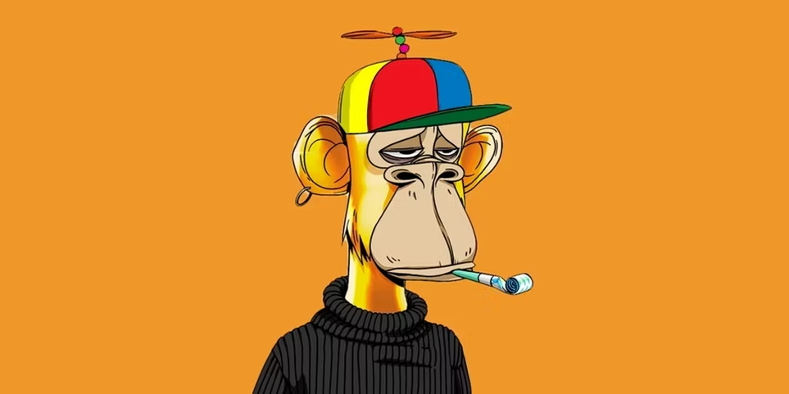
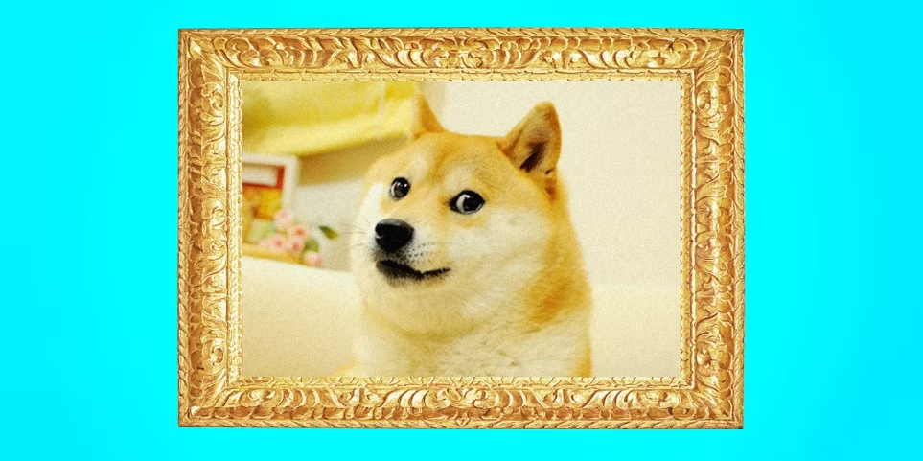
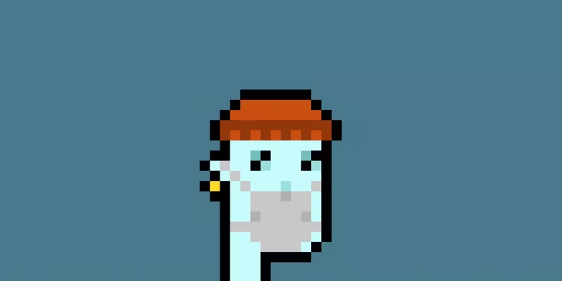
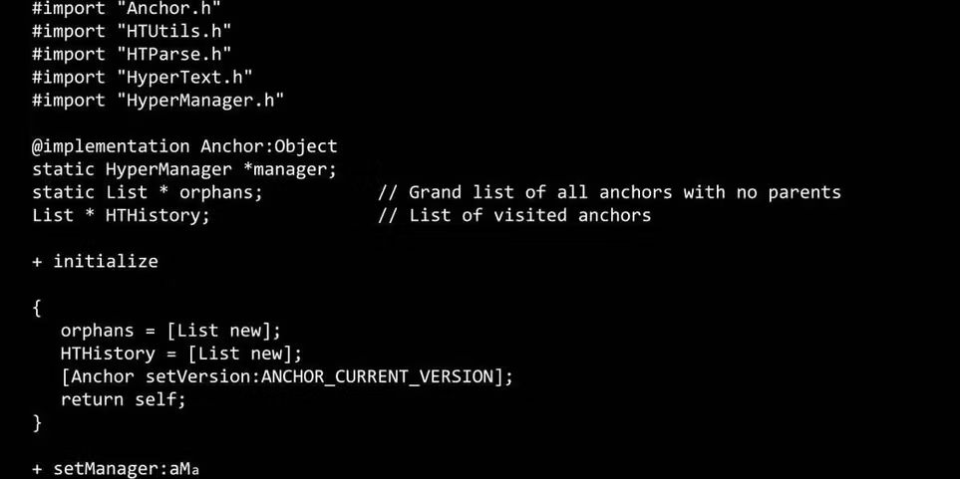
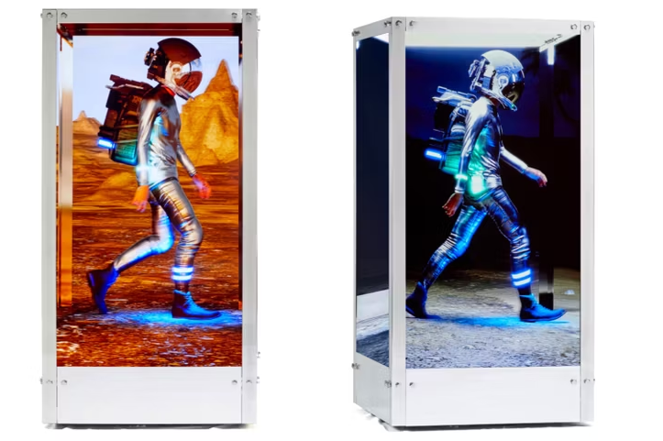
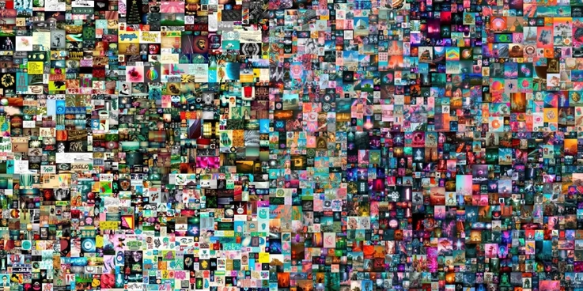
FAMOUS NFTS
Bored Ape (3.14 Million)
Doge ($4 Million)
CryptoPunk ($11.7 Million)
The First 5000 Days ($69 Million)
This Changed Everything ($5.4Million)
Human One ($28.9 Million)

Slide 5
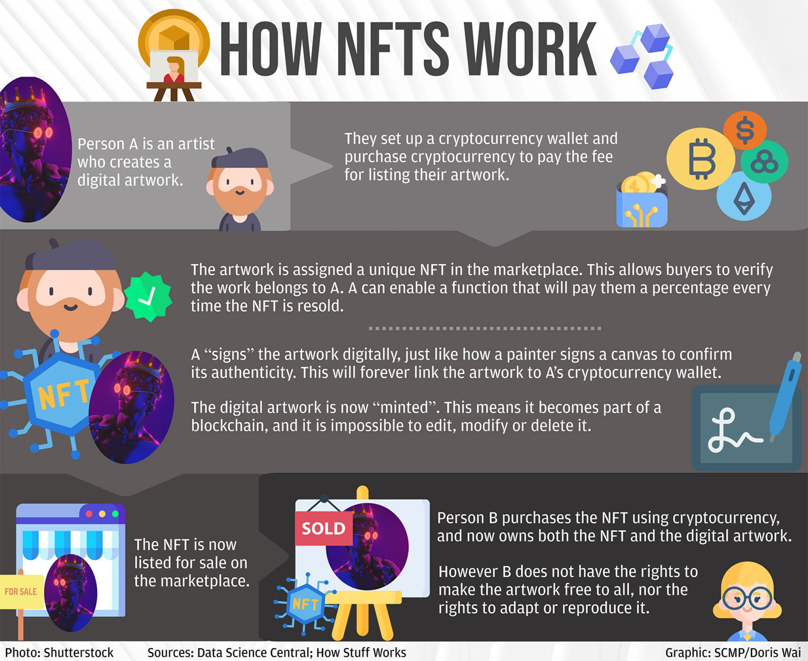

Slide 6
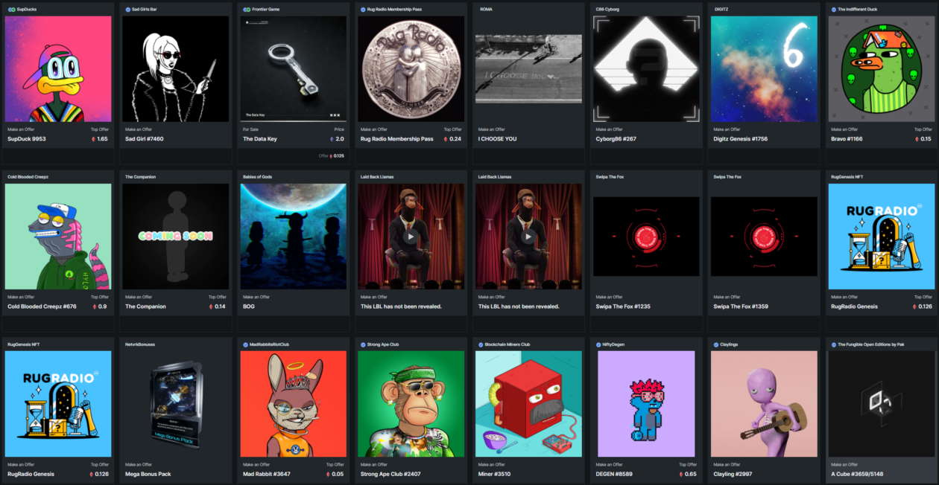
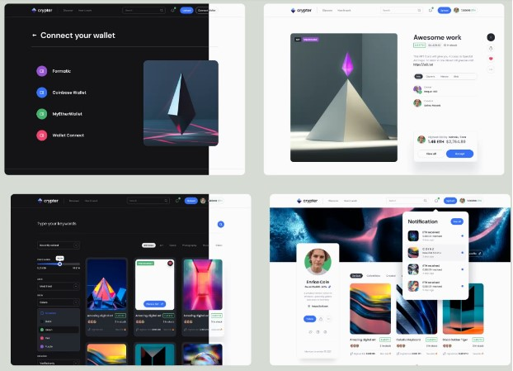
WHAT IS NFT MARKET PLACE?
NFT marketplaces play a crucial role in bridging the gap between buyers and sellers. In some cases, NFT marketplaces could also offer additional tools for creating NFTs within few minutes.
The specialized marketplaces allow artists to put up their NFT artworks for sale. Buyers could browse the marketplace for NFTs and purchase the item of their choice through bidding. Therefore, any NFT developer or enthusiast must go through the NFT marketplace list to ensure profitable deals on the artwork, collectibles, and other digital assets.

Slide 7
THE ACE COLLECTION
Low fees and gas-free transactions.
Upload any Video ,3d model, Music , Animations, Game skins.
Well established Ethereum based blockchain system.
Log History of all transaction of a specific NFT.
Special 5% Royalty to the creator on each transaction.

Slide 8
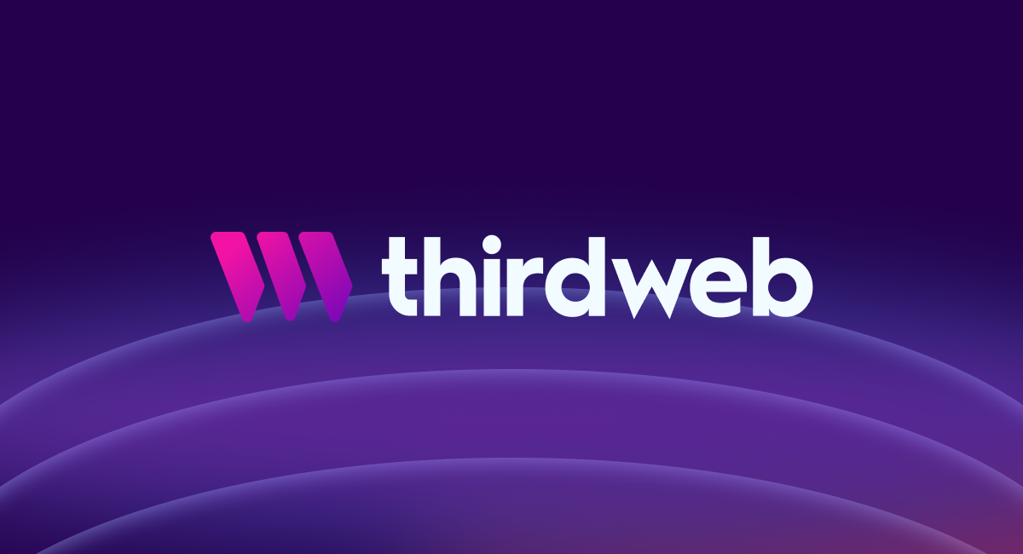

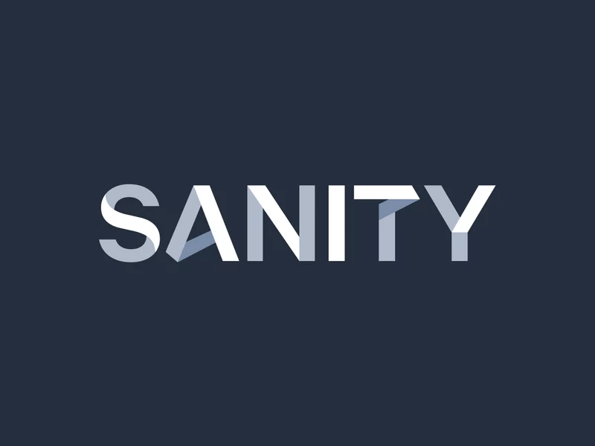
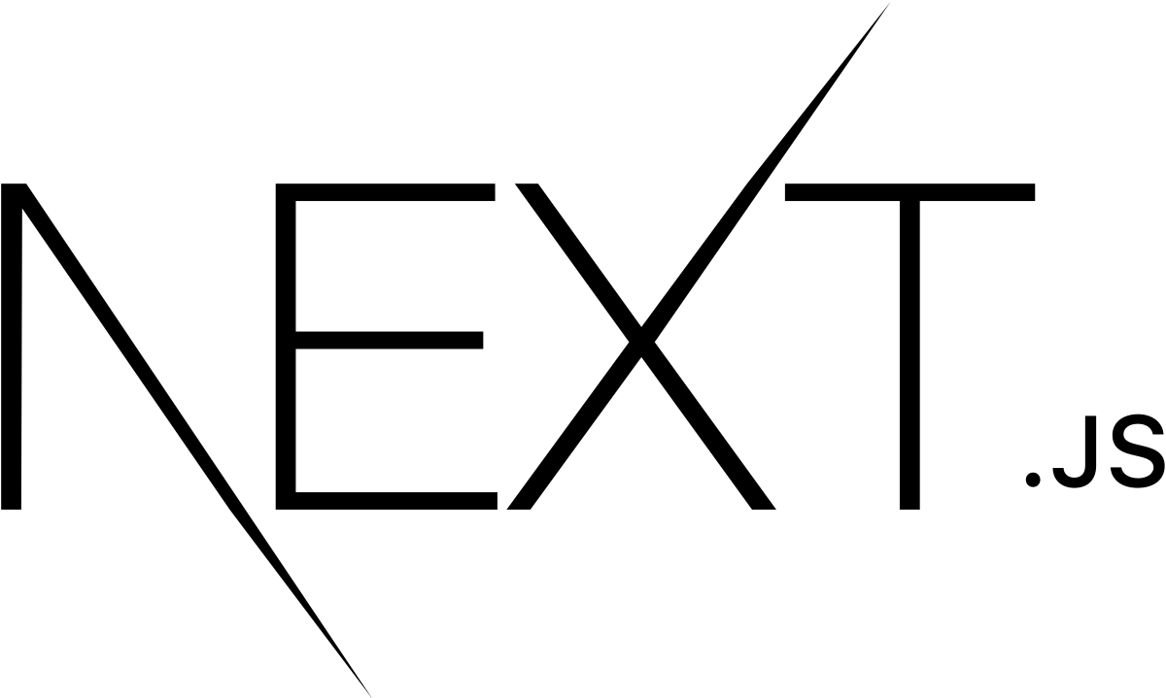
TECHNOLOGY USED

Slide 9
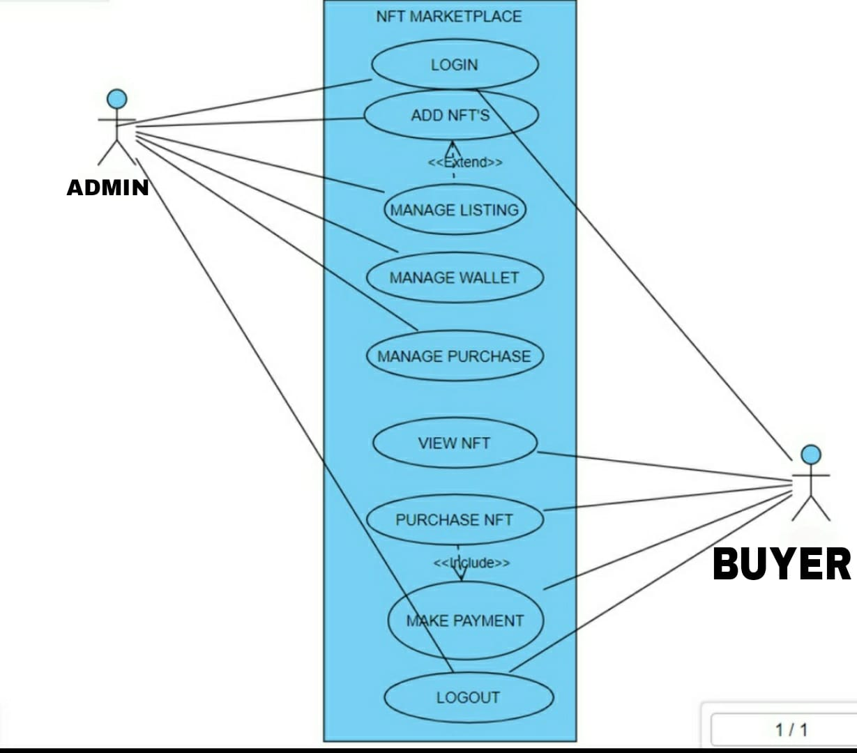

Slide 10
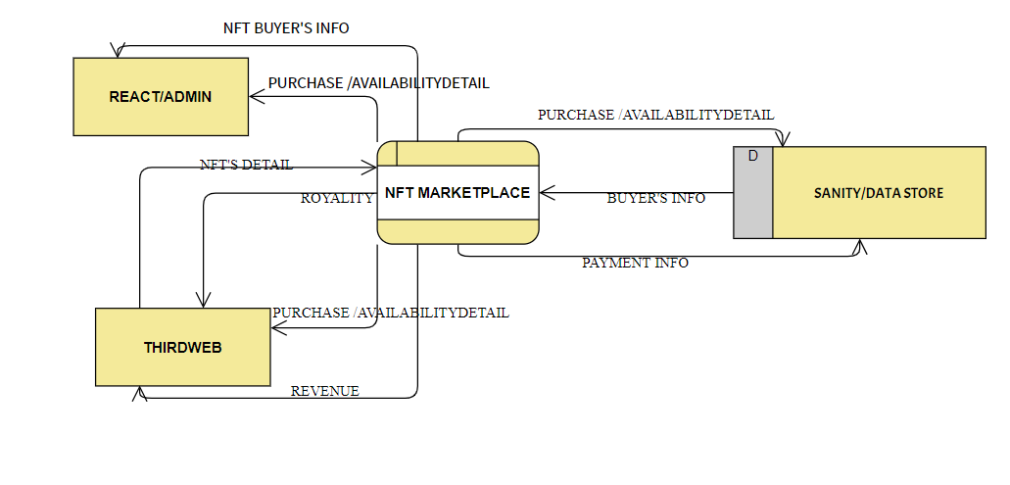
DFD LEVEL 0

Slide 11
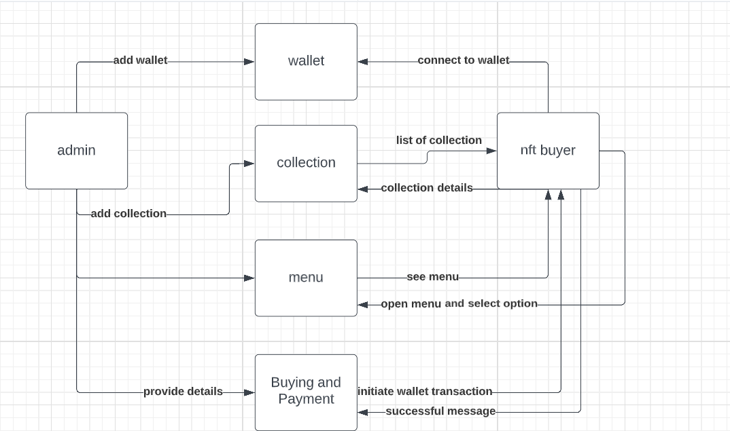
DFD LEVEL 1

Slide 12
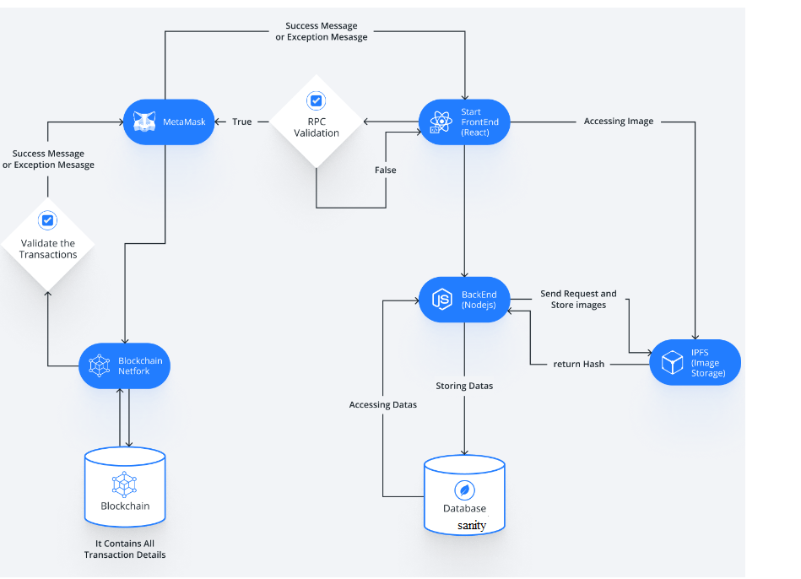
ACTIVITY DIAGRAM

Slide 13
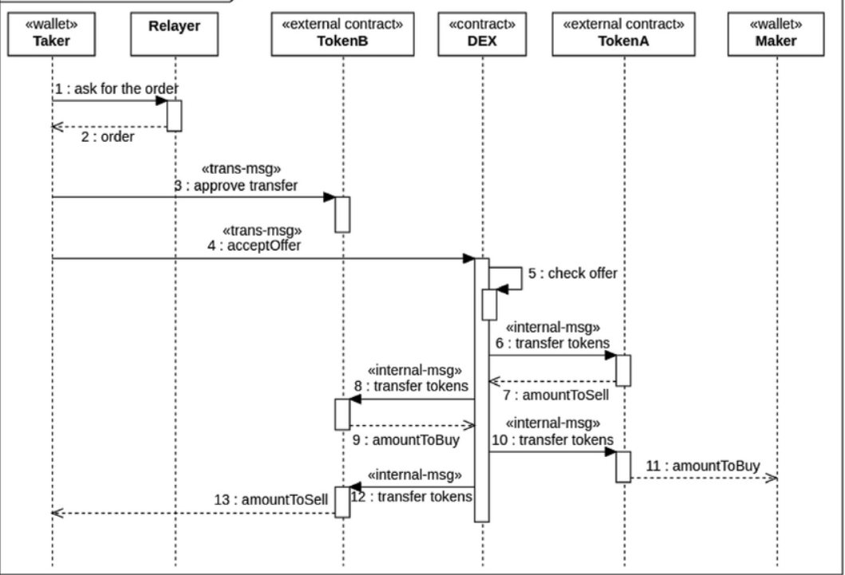
Sequence Diagram

